Slide 1

CureDAO
An Open-Source Collaborative​
Framework for Digital Health ​
.
Litepaper - CureDAO
.
CureDAO (github.com)
.
CureDAO

Slide 2
Table of contents
Introduction
Our Why The Problem & Solution
Compensation Plan
Roadmap
Follow Us
03
05
08
25
30
31

Slide 3
Who We Are
CureDAO is a decentralized autonomous organization (DAO) of citizen scientists, governments, businesses, and nonprofits devoted to the minimization of suffering.

Slide 4
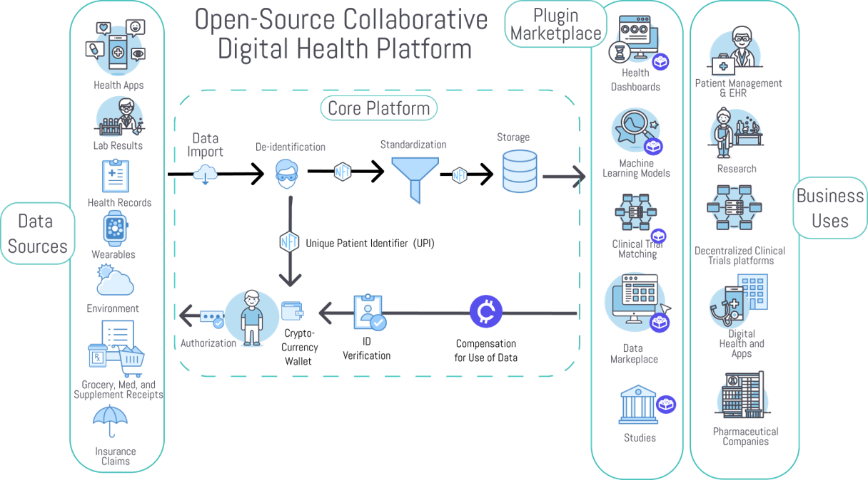

Slide 5

Why is this necessary?

Slide 6
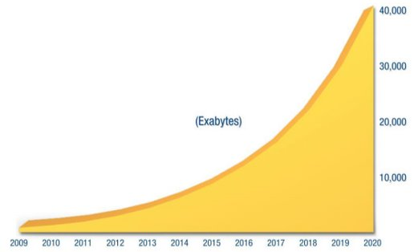

We’ve Seen a 50X Growth in Health Data Over the Past 10 Years​
And the creation of 350,000 digital health apps​

Slide 7
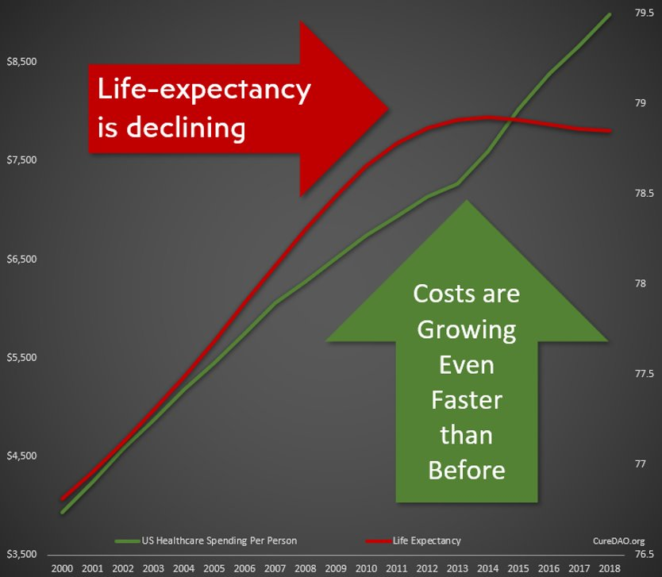
Yet All of This Innovation and Data has Failed to Improve Lifespan or the Cost Burden of Chronic Disease​

Slide 8

The Problem: Collaboration & Data Sharing​
is Punished by the Market​
We’re wasting $157 billion paying over 350,000 programmers to write the same code to implement the same basic functionality. ​
Horizontal Stagnation​

Slide 9
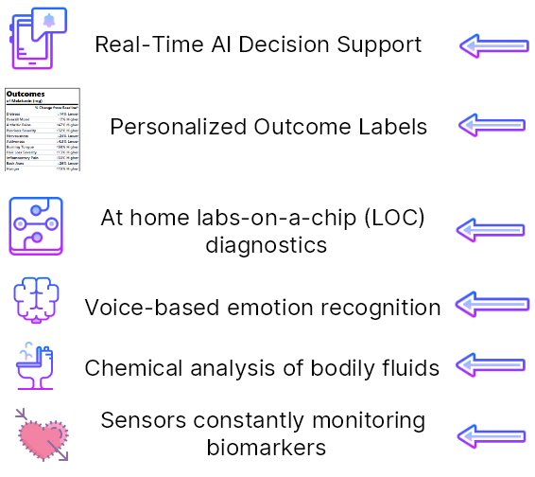
Vertical Innovation​
How we could be spending that
$157 Billion

Slide 10
Nearly all apps allow you to provide data and show you what you have done rather than what you should do to prevent or treat disease.​
The Result: Thousands of Dashboards​

Slide 11
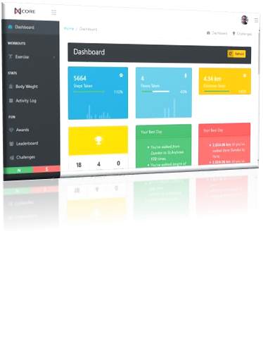
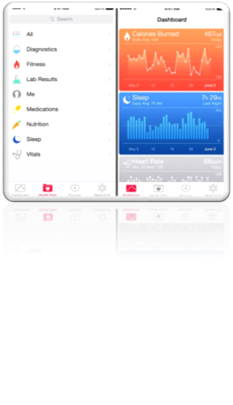
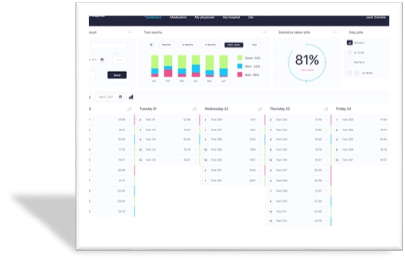

Slide 12

Solution: Incentivize Open-Source Collaboration​
We can utilize a DAO as a vehicle to reward the creation of public goods. ​This allows everyone to stand on everyone’s shoulders, massively accelerating progress. ​
Vertical Innovation​

Slide 13







An Open-Source Ecosystem Model of Success​
The WordPress Foundation​
Automattic (Wordpress.com)​
Maintains the Core WordPress Publishing Platform​
For-Profit Company
GPL Open-Source License
SaaS Managed WordPress Hosting
60% Global Market Share
$7.5 Billion Valuation
Volunteer contributors make money by selling products and services based on WordPress
Hosting plans range from freemium to $15,000/month
Icons from Free Vector Icons

Slide 14
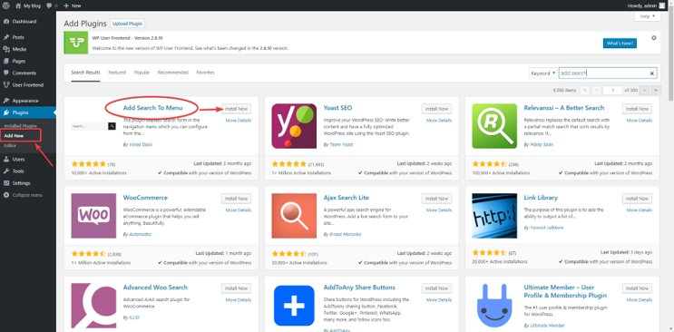
There are more than 59,000 WordPress plugins
The Open-Source Plugin Framework is the Most Critical Factor in its Versatility and Ability to Attract Developers

Slide 15








Plugin Marketplace
Free and paid add-ons for importing, collecting, and analyzing data, managing patients, collecting trials, and publishing studies
Data Sources Storage Visualisation Machine Learning EHR Clinical Trials
OpenCures Trial Management
OpenCures Personal Health
OpenCures Assays & Biobanking
Health Score Widget
We serve organizations with all the tools and automations they need to manage participants, their health data and workflows for their clinical, product.
Think of it as your sixth sense for health. Aggregate health data from all sources like wearables, apps, labs, EHR and make your own advanced statistical analysis.
You should own your health data. We let you also own your samples and provide access to assays like metabolomics and proteomics only available to research do far.
Embeddable health score gauge widgets for lots of biomarkers. Sends notifications when outside optimal ranges.
Icons from Free Vector Icons

Slide 16
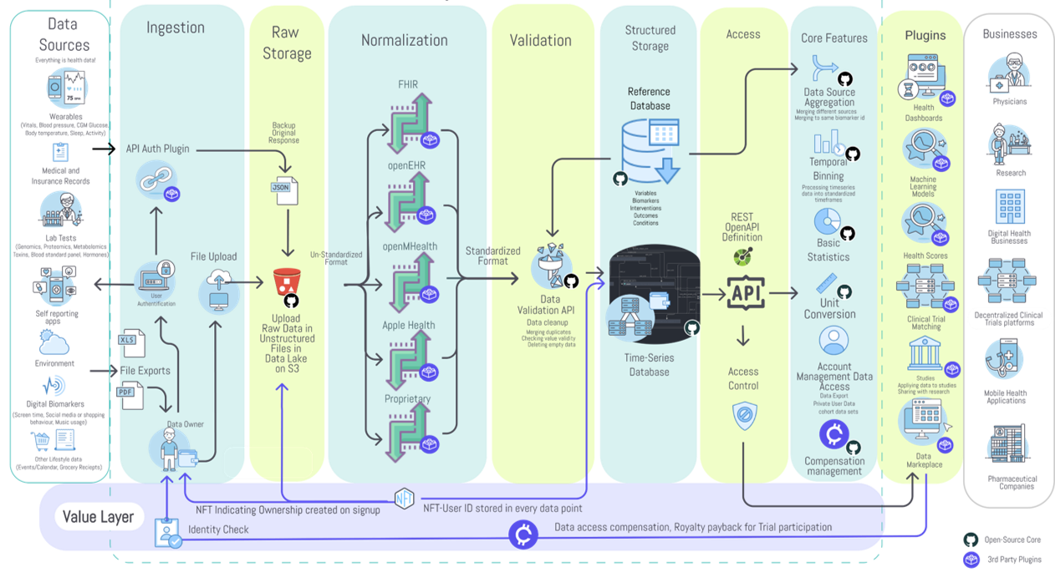

Slide 17
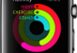







Importer Plugins
Automatically pulls data from apps and devices

Slide 18
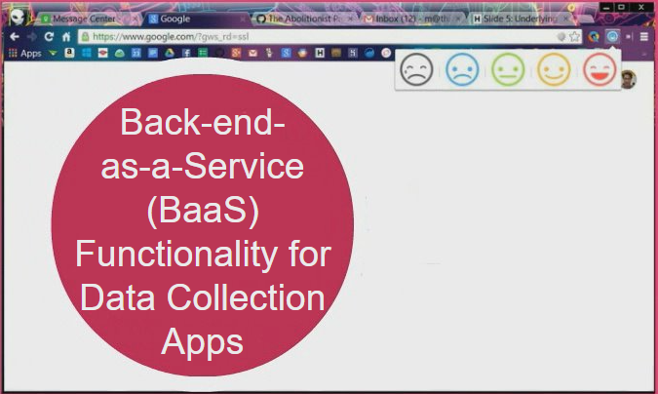

Data Collection Plugins

Slide 19



Data Analysis Plugins



Data Normalization, Cleaning and Standardization
Mines Data for Relationships Using Pharmacokinetic Modeling
Determine Values Which Lead To Optimal Outcomes
Icons from Free Vector Icons

Slide 20
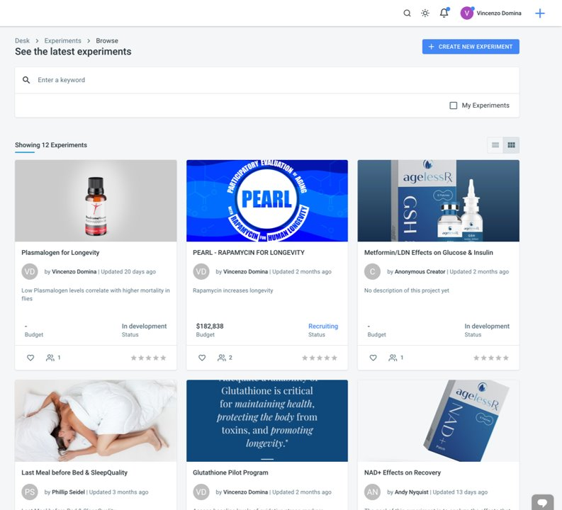
Open​ Cures​ Trial​
Management​ Plugin

Slide 21
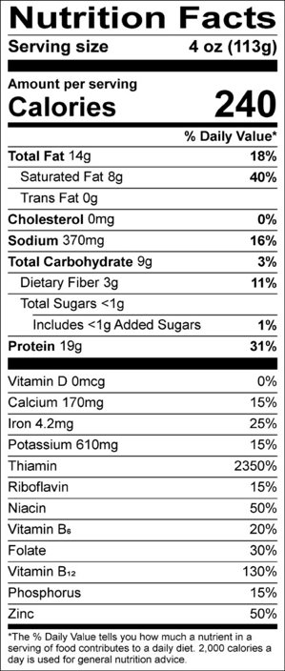
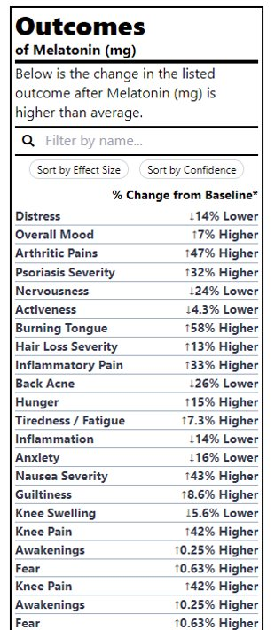
Outcome Labels​
Plugin
It would be far more valuable to know the health effects of different foods than the amount of riboflavin​

Slide 22
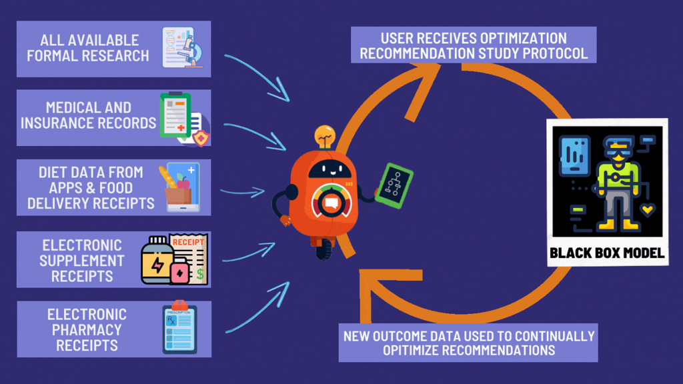

Slide 23
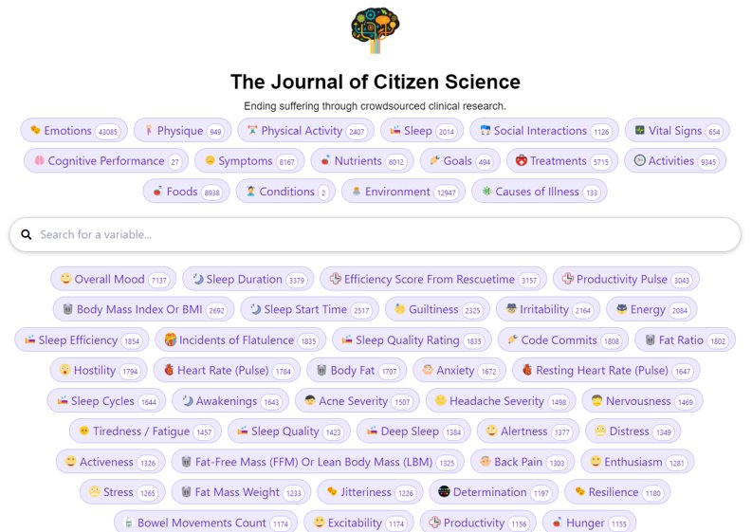
Study Generation Plugins
We’ve created 80,00 studies examining the effects of various factors on symptom severity​

Slide 24
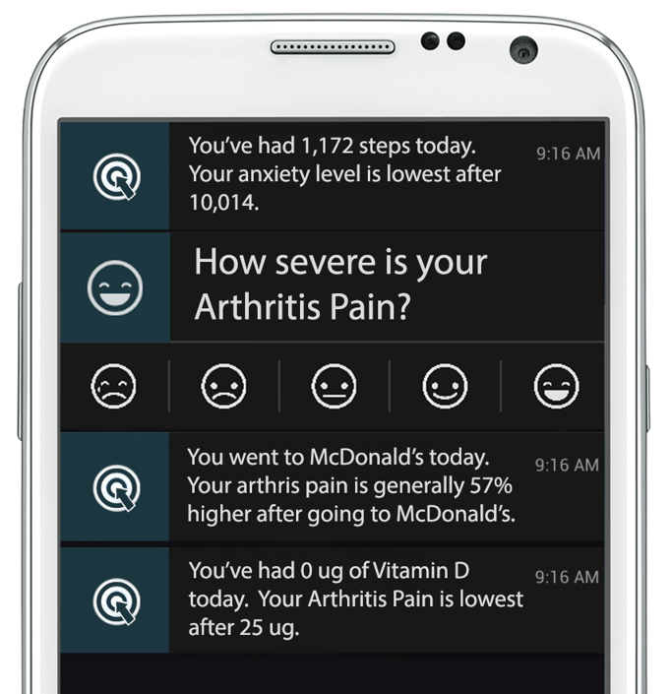
Decision-Support Notification Plugins​
We’ve created 80,00 studies examining the effects of various factors on symptom severity​

Slide 25



How to Incentivize Collaboration ​
and Data Sharing​
International Regulatory Epidemiological Natural Experiments​
Facilitate De-identified User Data Sharing​
Reduce Healthcare Expenditure by Facilitating Preventative Discoveries​
Government
Corporate Data Silos​
Reduced R&D Costs Through Decentralized Clinical Trial Platform. De-identified Data for Drug Discovery​
Software or Data​
Reduced Development Costs Through Use of White-Label Use of Platform​
Drug Companies
Digital Health Businesses​
Icons from Free Vector Icons

Slide 26

How to Incentivize Collaboration ​
and Data Sharing​
Personalized Recommendations for Prevention and Treatment of Disease​
Promotion of Studies​
Individuals​
De-identified Data Contribution​
Promote Research and Member Engagement More Productive Than Charity Walks​
Ongoing NFT Royalties
Non-Profits​
Ongoing NFT Royalties
Developers and Contributors​
Code, Content and IP Contribution​
Icons from Free Vector Icons

Slide 27
Total Addressable Market​
613 Million People Track a Health Indicator​
$3 /user/year​
$1.8 Billion TAM​

Slide 28


CLOSED-SOURCE ALTERNATIVES​
Company | Price per user per year | Data Aggregation | Open-Source | Plugin​ Marketplace | Research Platform
 | $5 | ✓ | ✗ | ✗ | ✗
 | $4 | ✓ | ✗ | ✗ | ✗
CureDAO | $3 | ✓ | ✓ | ✓ | ✓

Slide 29
Team Traction​
80,000 Studies Examining the Effects of Factors on Health Outcomes
10,000 Users in Over 50 Countries
300 Diagnostic Test Customers
12 Million Data Points Obtained
23 DAO Members

Slide 30
Q1/2022
Create Whitepaper, Website, Media presence, CI​
Define collaborators and partners (DAO infrastructure, health data tech)​
Setup DAO architecture and infrastructure​
Build community, social media content​
Fundraising phase (Genesis)
Build the DAO
Q2/2022
Collaborators vote for core features​
Build MVP alongside use in showcase trial​
Closed Testing with collaborators​
Release V1 of the Software Framework​
Open Testing with partners
Minimal Viable Product(MVP)
Roadmap​
Q3/2022
Integrate with other tech architecture (storage providers, data marketplaces, analysis software, etc.. )​
Integrate with operating health data standards and Electronic Health Record​
Build showcase plugins​
Release V2 of the Software Framework​
Promote broader usage
Integration and Testing
Q3/2023
Manage personal health to prevent disease​
Share health data to research​
Get to know new insights​
Take newly developed interventions​
Educate loved ones about longer health-span​
Minimize time to develop new interventions​

Slide 31



Follow us

.

Twitter
Discord
Our Website
Icons from Free Vector Icons

